Slide 1


Smart
C R OP C R AF T E R S

Slide 2
The project's scope is broad and covers various aspects of agriculture, including irrigation practices, automated pest management, livestock monitoring, field and inventory monitoring, and even maintaining the right proportions of essential plant nutrients
Mission
STATEMENT
(nitrogen, phosphorus, and potassium) in the soil using machine learning and image processing techniques. Ultimately, the project envisions a sustainable IoT solution that makes traditional agriculture practices more accessible and efficient.

Slide 3

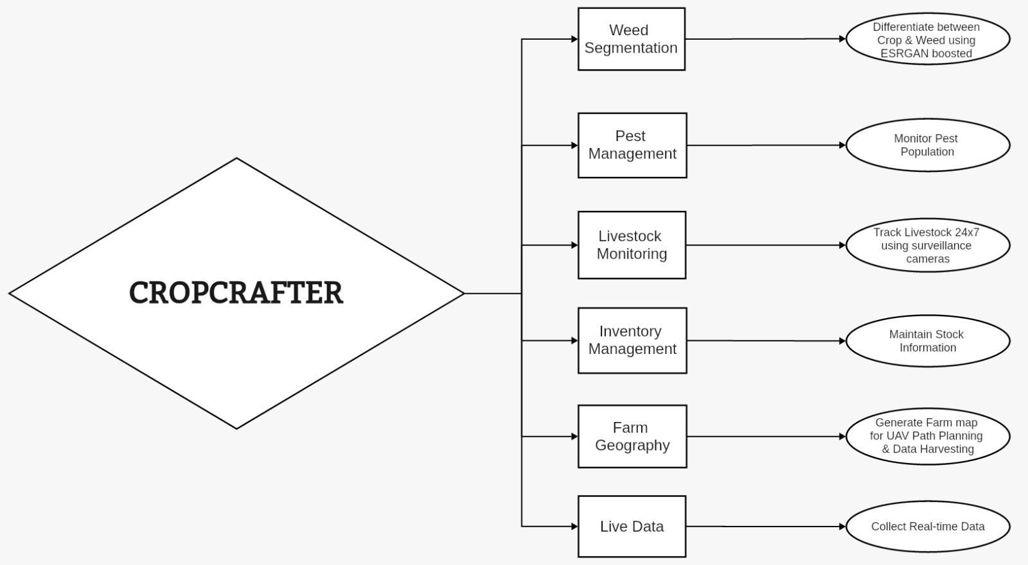
Proposed
O B J E C T I V E S

Slide 4
UAV PATH PLANNING & DATA HARVESTING
PURPOSE OF UAV PATH PLANNING
UAV path planning ensures efficient and safe navigation for drones, optimizing flight paths to achieve specific objectives.
IMPORTANCE OF DATA HARVESTING
Data harvesting involves collecting and analyzing valuable information using sensors and devices mounted on UAV. UAV gather various data types such as aerial imagery, and environmental parameters.
ADVANTAGES OF INTEGRATING PATH PLANNING AND DATA HARVESTING
Integrating path planning and data harvesting maximizes efficiency, enhances data quality, reduces flight time, and enables targeted data collection.

Slide 5

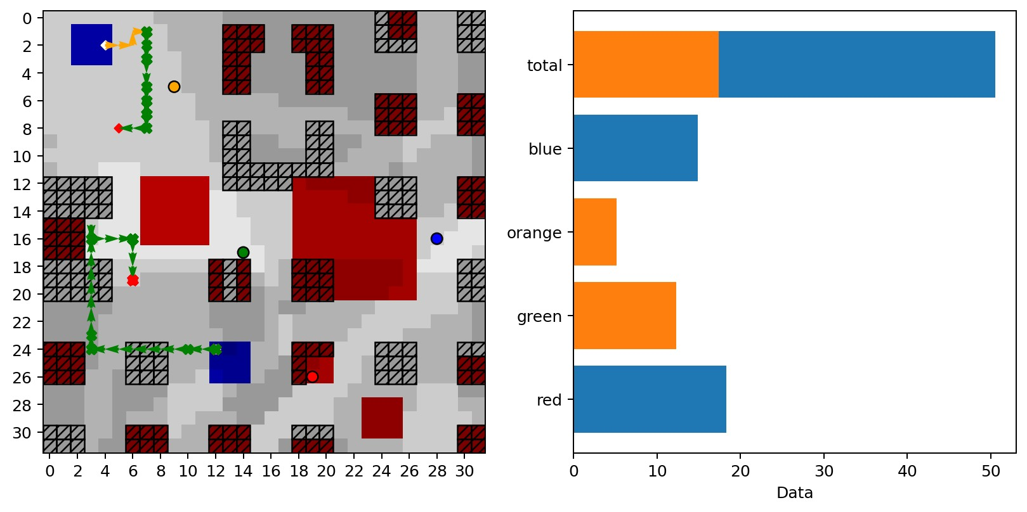
UAV PATH PLANNING & DATA HARVESTING

Slide 6
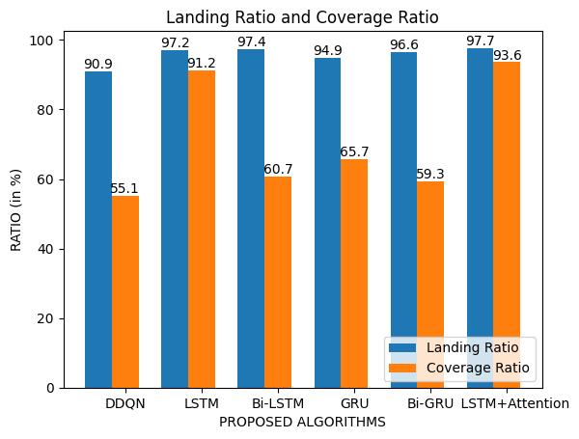
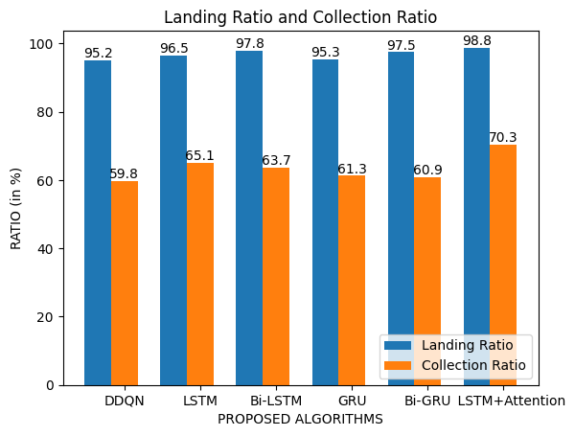
NOVELTY
PATH PLANNING
DATA HARVESTING

Slide 7

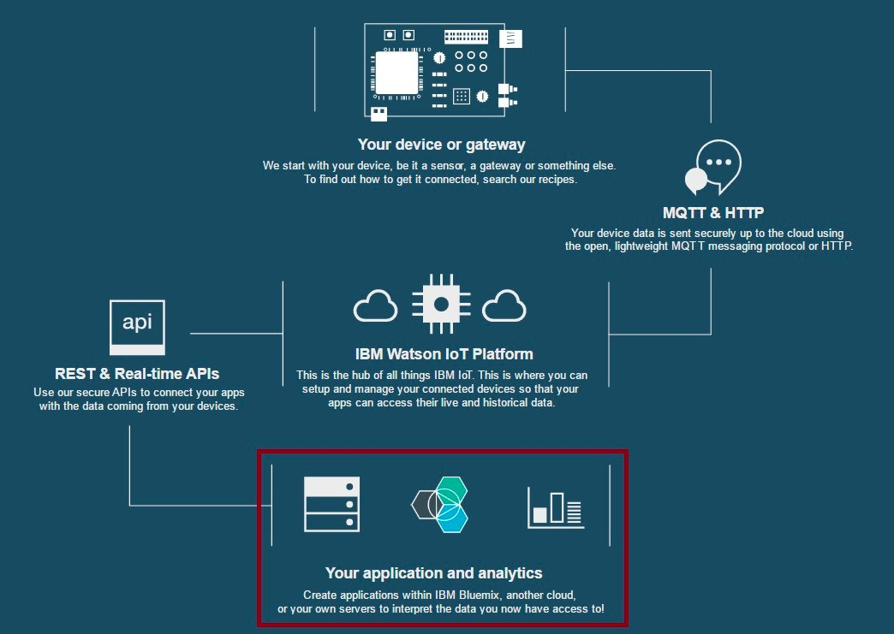
DATA STORAGE

Slide 8
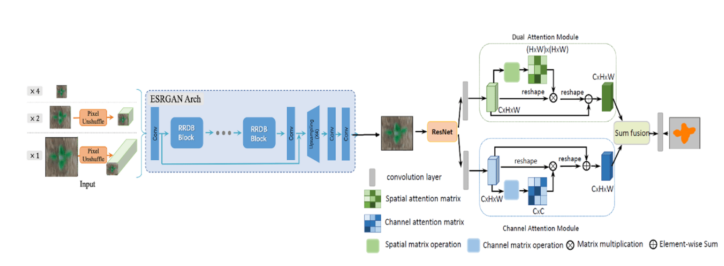
WEED SEGMENTATION

Slide 9
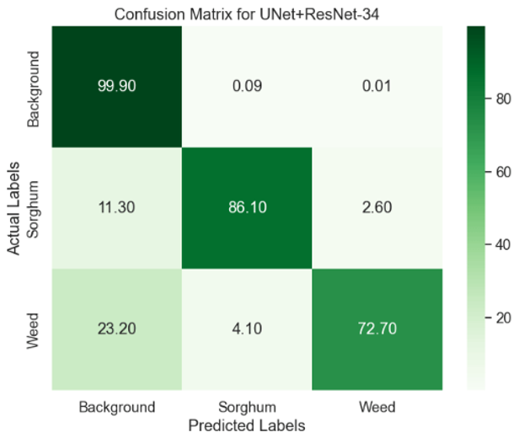
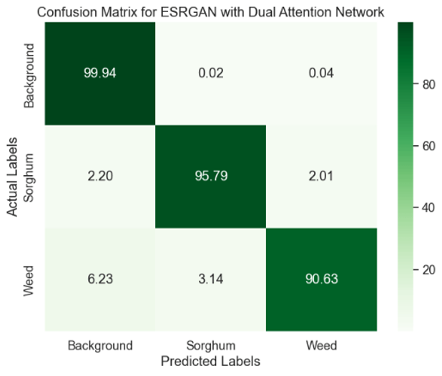
NOVELTY
EXISTING
OUR PROPOSED ALGORITHM

Slide 10
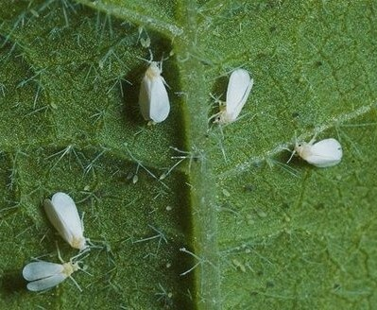
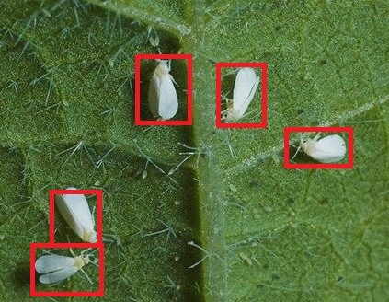
PEST MANAGEMENT
INPUT IMAGE FROM UAV
OUTPUT IMAGE FROM UAV

Slide 11
Introducing our innovative prototype: where ideas become reality

Slide 12
THANK YOU

